Slide 1
Threat Portal Live Map
Notes:
https://threatmap.checkpoint.com/ThreatPortal/livemap.html

Slide 2
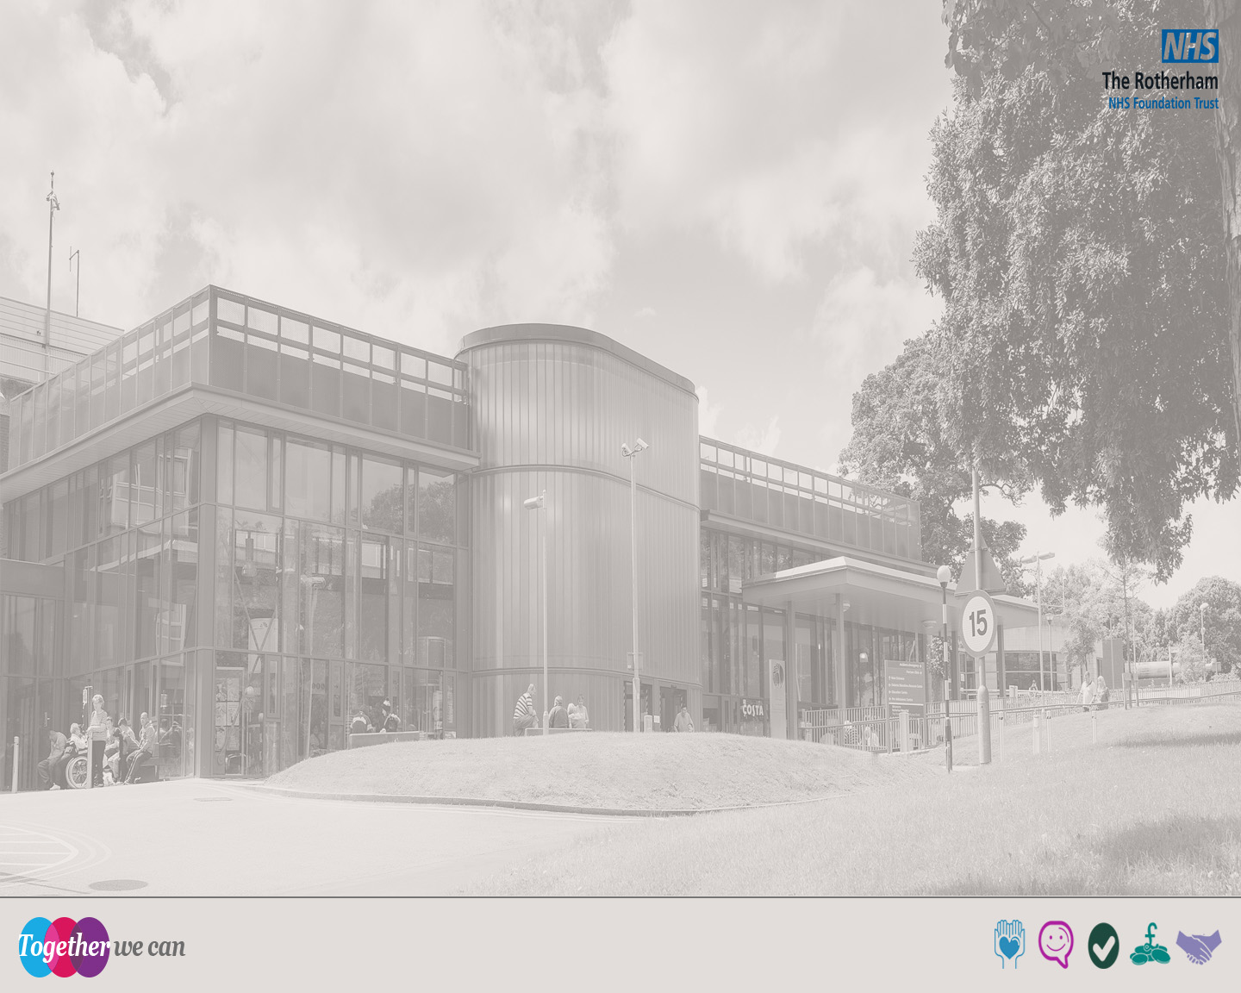


Data Security Awareness Level 1

Slide 3
Technology enables us to deliver a better quality of care
Data Security has always been important.
More complex now technology is so central to delivery of health and care.
Uses technology so does not pose unacceptable risk to organisation or patients / service users.
We all have a duty to protect people’s information in a safe and secure manner.
Information can be shared more quickly
Powerful analysis can be performed to improve the future of care

Slide 4
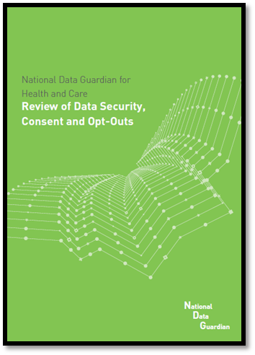

Safe data, safe care
Good information underpins good care. Patient and service user safety is supported by:
  Confidentiality
  Integrity, and
  Accessibility.
Patients / service users must feel assured that their information is used appropriately.
Notes:
Talk about the fact that DPA/GDPR and Caldicott go hand in hand. Talk about the recent review and what impact the opt-outs may have.
Talk about the 10 Data Security Standards, particularly the test.

Slide 5
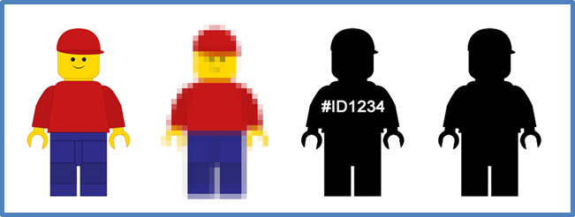
Types of information
In health and care settings, there are various types of personal information.
It is important to be able to identify these different types of information so that they can be appropriately protected when they are used and shared.

Slide 6
Types of information
In health and care settings, you might see:
  Confidential information.
  Sensitive information.
  Personal information.
  Pseudonymised information (cannot contain names and addresses)
  Anonymised information. (cannot be personal or confidential)
  Health and care information is valuable
Losing information, including paper records, over the phone, via faxes, loss of computers or mobiles phones
Theft of information, such as by clicking on links to fake websites (phishing)
Insecure storage and disposal of information leading to loss or theft
Notes:
Discuss the different types of information.

Slide 7
Common law duty of confidentiality
Information that individuals disclose in confidence should not be used or shared further without a lawful reason: The lawful reasons are:
  The consent of the individual. (personal information)
  Where there is a legal reason to disclose information.
  Where there is a public interest justification.
A decision to disclose without consent should be made by senior staff.
Notes:
Discuss Consent/Law and the fact that law should always be the first consideration.

Slide 8

Confidentiality – Good practice
We have a legal duty to respect the privacy and to use personal information appropriately
The main aspects of confidentiality
good practice are:
  Informing people
  Sharing information for care
  Sharing information for non-care
  It is not necessary to get consent every time you subsequently share for the same purpose
✓

Slide 9
GDPR incorporated into UK law as
Data Protection Act 2018
Organisations can be fined or face legal action
for breaching the principles of the Act.
6 Data Protection Principles
  Lawfulness, fairness and transparency
  Purpose limitation - Specified, explicit and legitimate purpose.
  Data minimisation – adequate, relevant and limited to what is necessary.
  Accuracy – accurate and where necessary kept up to date.
  Storage limitation – kept in a form which permits identification of data subjects for no longer than is necessary.
  Appropriate Security – data is secure and processed in line with organisational measures.
You as an individual can also be held responsible for a data breach
under the Data Protection Act 2018/GDPR

Slide 10
The Caldicott Principles (2 & 3)
Principle 1: Do you have a justified purpose for using confidential information?
Principle 2: Is it absolutely necessary to do so?
Principle 3: Are you using the minimum information required?
Principle 4: Are you allowing access to this information on a strict need-to-know basis only?
Principle 5: Do you understand your responsibility and duty to the subject with regards to keeping their information secure and confidential?
Principle 6: Do you understand the law and are you complying with the law before handling the confidential information?
Principle 7: Do you understand that the duty to share information can be as important as the duty to protect confidentiality?
Notes:
Discuss and mention Principle 7 added to Caldicott 2. Mention Caldicott 3 (the review).

Slide 11
National Data Guardian
Security Standards
All staff ensure that personal confidential data is handled, stored and transmitted securely, whether in electronic or paper form.
All staff understand their responsibilities under the National Data Guardian’s Data Security Standards including their obligation to handle information responsibly and their personal accountability for deliberate or avoidable breaches.
All staff complete appropriate annual data security training and pass a mandatory test, provided through the revised Information Governance Toolkit.

Slide 12
The Freedom of Information Act 2000
The Act allows anyone from anywhere in the world to make a written request for information held by a public body.
The Act only applies to information that already exists in a recorded form.
Coverage - not all organisations have to comply with the Act. Is your organisation type listed below?
Local authorities, health bodies and regulators, dentists, general practitioners, optical contractors and pharmacy businesses must comply with the Act.
Private health and care providers should check their contract for any duty to comply with the Act.
Charities and similar organisations may deal with FOI requests on a voluntary basis.

Slide 13
Can you recognise a valid request?
Identify which ones you think are valid FOI requests and which you think are not valid FOI requests |  | Valid | Not valid
A. | Please send me a copy of my social care record
B. | How many GPs work in the practice?
C. | When’s my daughter’s next appointment?
D. | How much did the Trust spend on rail travel last year?
E. | How many staff have passed their IG training?
F. | What services are being considered for closure in the next year?

Slide 14
Can you recognise a valid request?
Identify which ones you think are valid FOI requests and which you think are not valid FOI requests |  | Valid | Not valid
A. | Please send me a copy of my social care record |  | ✓
B. | How many GPs work in the practice? | ✓
C. | When’s my daughter’s next appointment? |  | ✓
D. | How much did the Trust spend on rail travel last year? | ✓
E. | How many staff have passed their IG training? | ✓
F. | What services are being considered for closure in the next year? | ✓

Slide 15
How long does our organisation have to respond to a subject request under the Freedom of Information Act?
20
Working Days

Slide 16
Data Protection - Good Practice
Follow your organisation’s policies and procedures.
No surprises - handle people’s information as you’d expect others to handle your personal information.
Include the NHS Number.
Remember - patients and service users have a right to see information recorded about them.
Follow the TRFT’s policy for disposing of personal information.
Know who is about – Have a sign-in procedure.

Slide 17
Data Protection - Good Practice (cont’)
Save records in a secure place that is easy to find.
Record information while the event is still fresh in your mind.
Make sure the information your record is accurate and up to date.
Report Incidents in a timely fashion – 72hr SIRI deadline

Slide 18
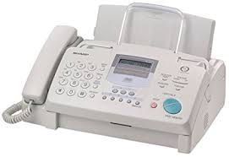
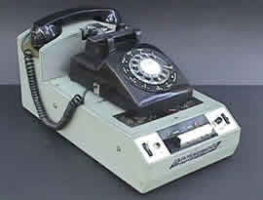
Can increase the risk of a breach

Slide 19

Email Phishing, Malware and Macros
Email though efficient has risks:
Criminals use email attachments and links to trick people into providing information.
Email attachments may be executable files that contain malicious software (malware). (EXE files)
This is known as phishing and the emails aim to force you to make a mistake.
Never give your login details to anyone.
If you receive an email requesting sensitive information that looks as though its from a colleague - double check by phoning the colleague.
Do not open links or attachments in unsolicited emails.
Report suspicious emails to the IT Service Desk (8844).

Slide 20
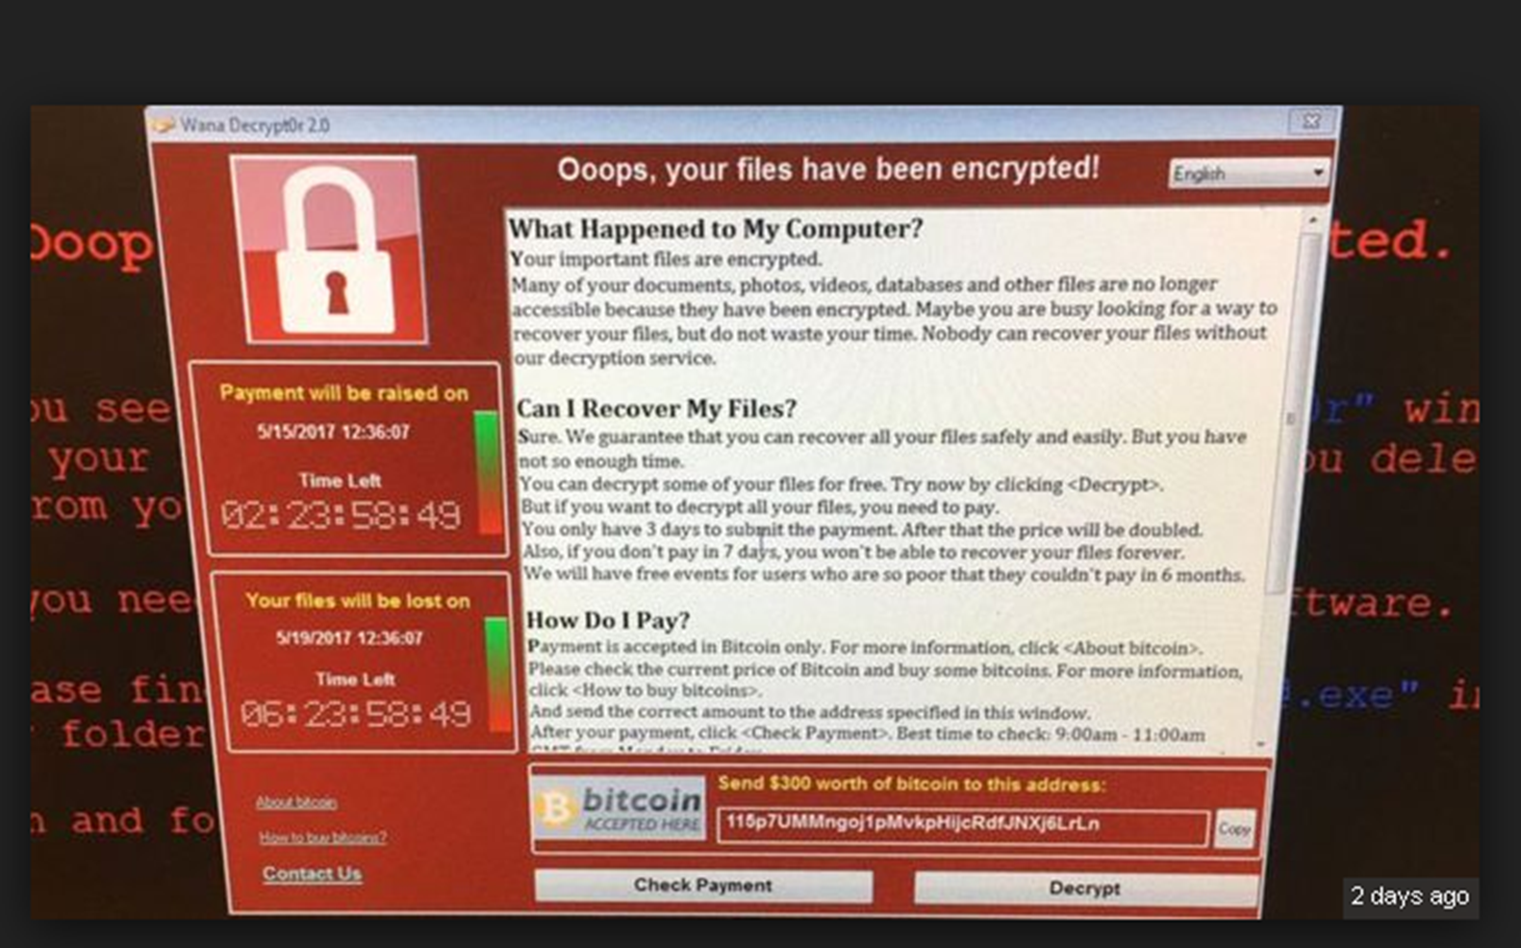

Slide 21
Social Engineering
Those who want to steal data may use tricks to manipulate people to give access to valuable information. This is called social engineering.
On the phone: A social engineer might call and pretend to be a fellow employee or a trusted outside authority (such as law enforcement or an auditor).
In the office: "Can you hold the door for me? I don't have my key/access card on me." How often have you heard that in your building? While the person asking may not seem suspicious, this is a very common tactic used by social engineers.
Online: Social networking sites have opened a whole new door for social engineering scams. One of the latest involves the criminal posing as a Facebook "friend”. But you can never be certain the person you are talking to on Facebook is actually the real person. Criminals are stealing passwords, hacking accounts and posing as friends for financial gain.

Slide 22
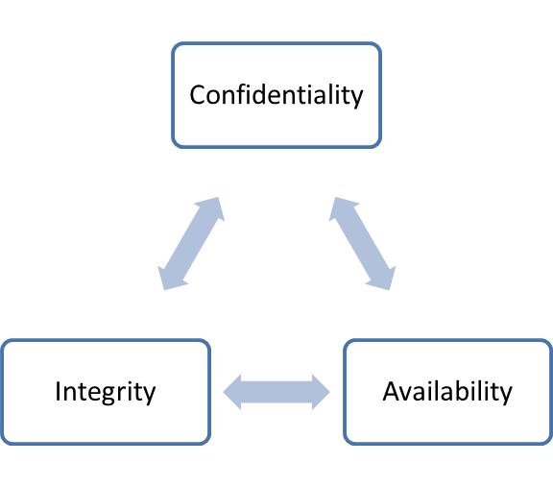
Patient and service user safety is supported when the Confidentiality of personal information is maintained, its integrity is protected against loss or damage, and the information is available to those who are authorised?
Notes:
Talk about this not only applying to IT systems. Talk about access rights, IAO and IAAs and asset registers.

Slide 23
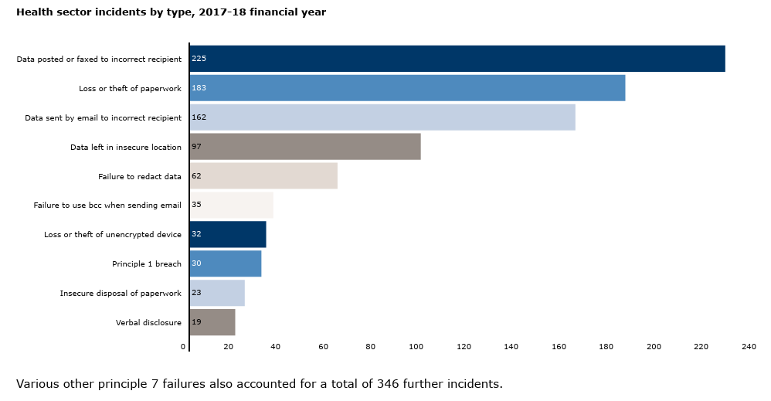
Data Security Incidents Trends

Slide 24
Reporting Incidents
A data incident takes place
Notify the IG team about the incident
In your notification you should include when, where and what business activity you were conducting when it happened.
Read TRFT IT Acceptable Use policy
Near misses where data was nearly lost or where there was nearly a breach should also be reported.
Consequences of breaches and incidents
Fine from the ICO of up to €20m
Reputation of the Trust/Loss of Public Confidence
Incidents
All incidents should be reported including near misses and Cyber (72hrs)
Notify IT if you receive suspicious emails or your PC is running slower than usual. Never attempt to disable things like anti-virus (auto update)

Slide 25
Rights of Individuals
Individuals have rights in relation to their information including:
  Make subject access requests. (Do it right)
  Have inaccuracies corrected.
  Have information erased (where it has not been relied upon to provide health or care).
  Object to direct marketing.
  Restrict the processing of their information.
Patient / service users might be able to view their record online – online access should not reveal information that they do not already know relating to 3rd parties.

Slide 26
DPA 1998 - Section 55
Now DPA 2018 - Section 170

Slide 27
Good Practice
Setting Passwords (a mix of characters)
Locking Devices
Removable Drives (use company provided)
Untrusted Websites
Mobile Devices
Disposal of Confidential Information
Clear Desks
Personal Use with authorisation only
Be aware of data security at home too

Slide 28
Postal checklist
Read the TRFT Mail Management Policy
Ensure you the correct envelope
Email Checklist
Read the IT Acceptable Use Policy
Ensure the email system you are sending to, can receive sensitive information [secure].
Refer to the IG Practical Guide – Do’s and Don’ts
When using NHS Mail, make sure you pick the correct recipient.
Phone Checklist
Read the Use and Protection of Patient Information Policy
Always ensure you know the identity of the person you are talking to.
If in doubt do not disclose.
Don’t disclose information on answering machines
Fax Checklist
Read the Fax and Safe Haven Policies
Only to be used as a last resort – ideally not to be used for PID
Ensure you follow the Safe Haven procedures

Slide 29

Any questions
or feedback?

